Slide 1
The Best Part of Lockdown
- By John and Vincent

Slide 2
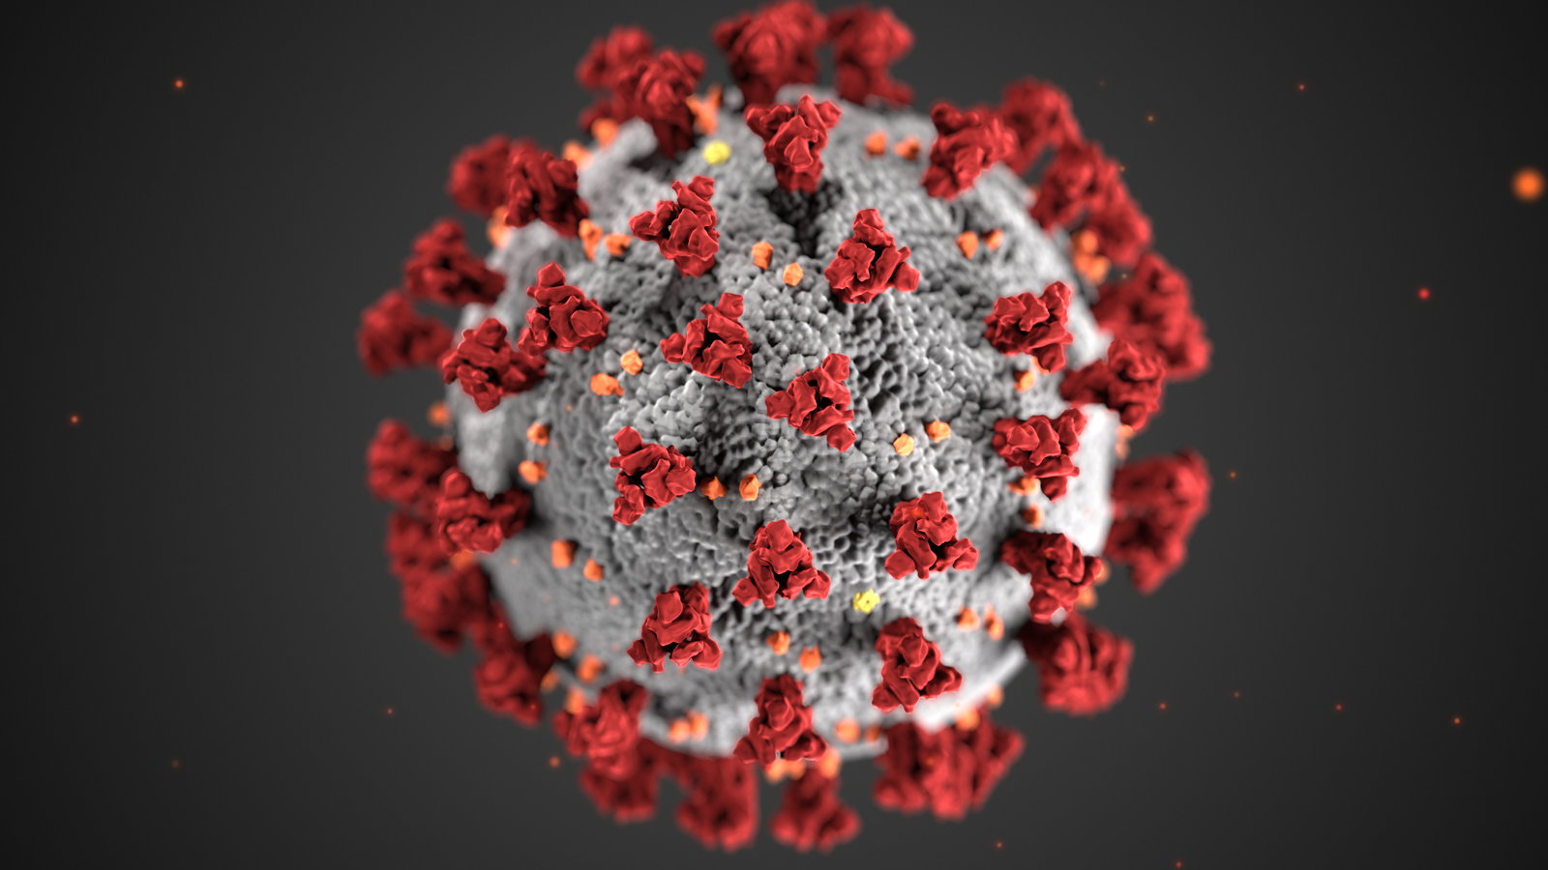
Our Main Ideas
Covid lockdown.
Tips to survive lockdown in 30 years time.
What we did.
Our hobbies.
Making a website for Rainbow Six Siege.

Slide 3
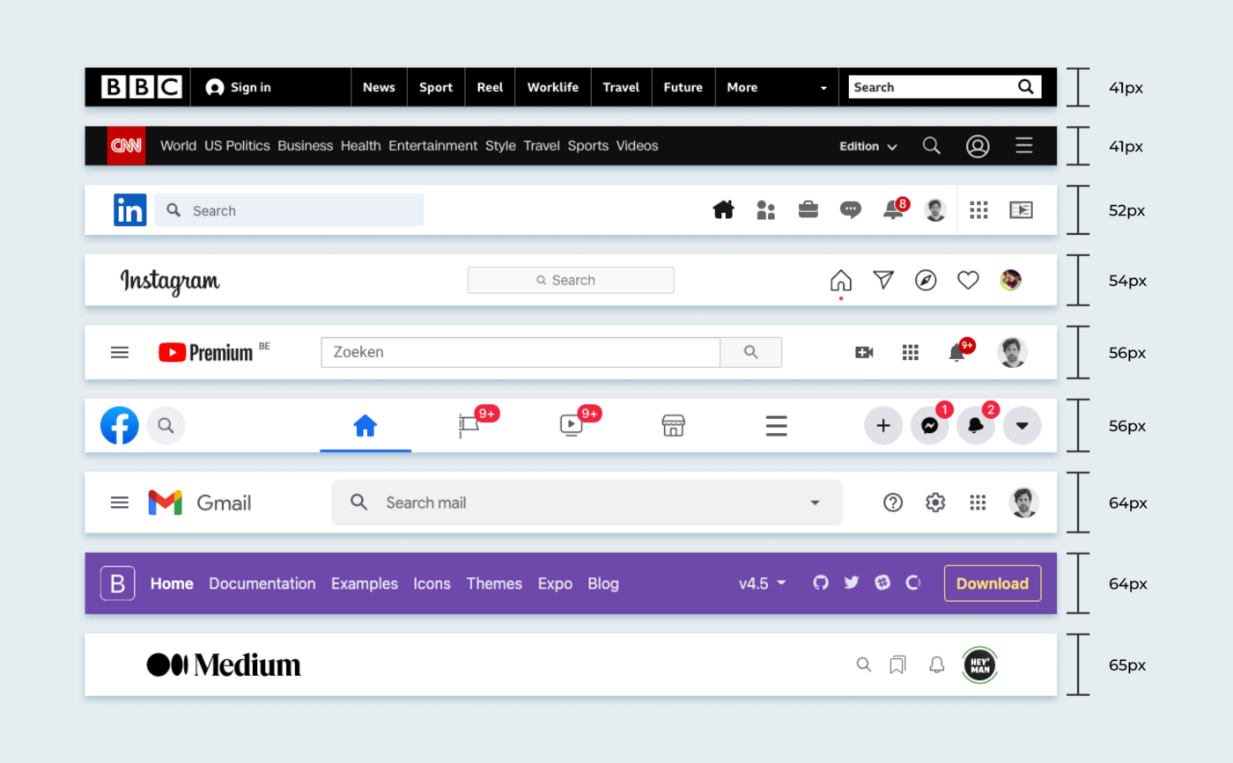

Our Plans for our Website
We are planning to include:
The use of HTML and CSS.
A white and grey colour scheme.
A navbar and footer.
CSS.

Slide 4
Thank you for listening

